Slide 1

Services and dependency injection

Slide 2

What is dependency injection?
Known to be a programming paradigm, dependency injection is what makes a class independent of its dependencies. Dependency injection enables the creation of dependent objects outside of a class while providing those very objects to a class in numerous ways.
Consider two classes, A and B. Let’s assume that class A uses the objects of class B. Normally, in OOPS, an instance of class B is created so that class A can access the objects. Using DI, we move the creation and binding of the dependent objects outside of the class that depend on them.

Slide 3
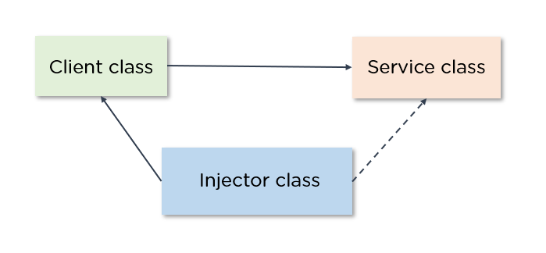
What is dependency injection?
Typically, there are three types of classes, they are:
Client Class - This is the dependent class, which depends on the service class.
Service Class - Class that provides the service to the client class.
Injector Class - Injects the service class object into the client class.

Slide 4
Types of Dependency Injection in Angular
There are three types of Dependency Injections in Angular, they are as follows:
Constructor injection: Here, it provides the dependencies through a class constructor.
Setter injection: The client uses a setter method into which the injector injects the dependency.
Interface injection: The dependency provides an injector method that will inject the dependency into any client passed to it. On the other hand, the clients must implement an interface that exposes a setter method that accepts the dependency.

Slide 5
Advantages of Dependency Injection
Dependency injection offers some incredible advantages. Here are some of them
Dependency Injection helps in Unit testing.
Boilerplate code is reduced, as initializing of dependencies is done by the injector component.
Extending the application becomes more manageable.
It helps to enable loose coupling, which is essential in application programming.

Slide 6
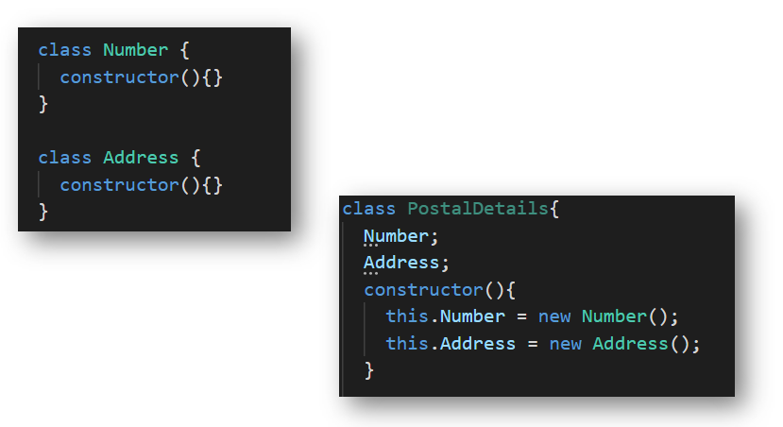
The Drawbacks of not using Dependency Injection
Consider a Postal details class that is dependent on the Number and the Address class

Slide 7
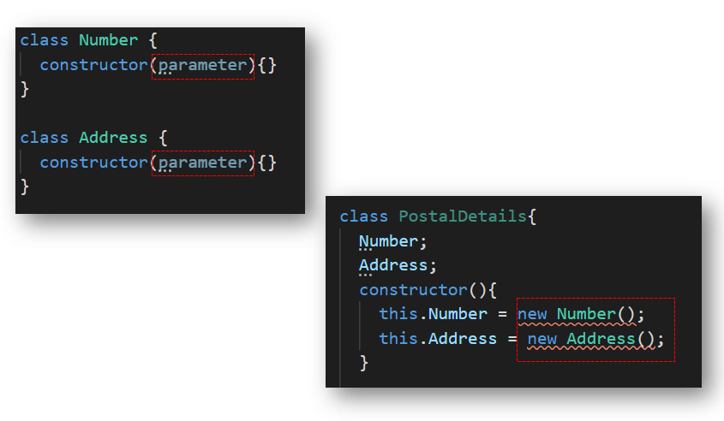
The Drawbacks of not using Dependency Injection

Slide 8
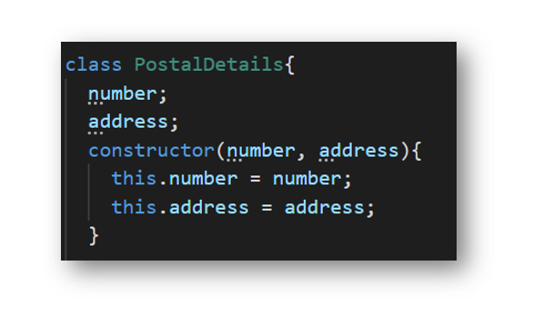
Dependency Injection as a Design Pattern

Slide 9
Thank you!
Contact :
mdjamtoski@gmail.com

